Slide 1
Day 2/100 Java Practice
100 Days of Coding Practice
Navaneethan

Slide 2
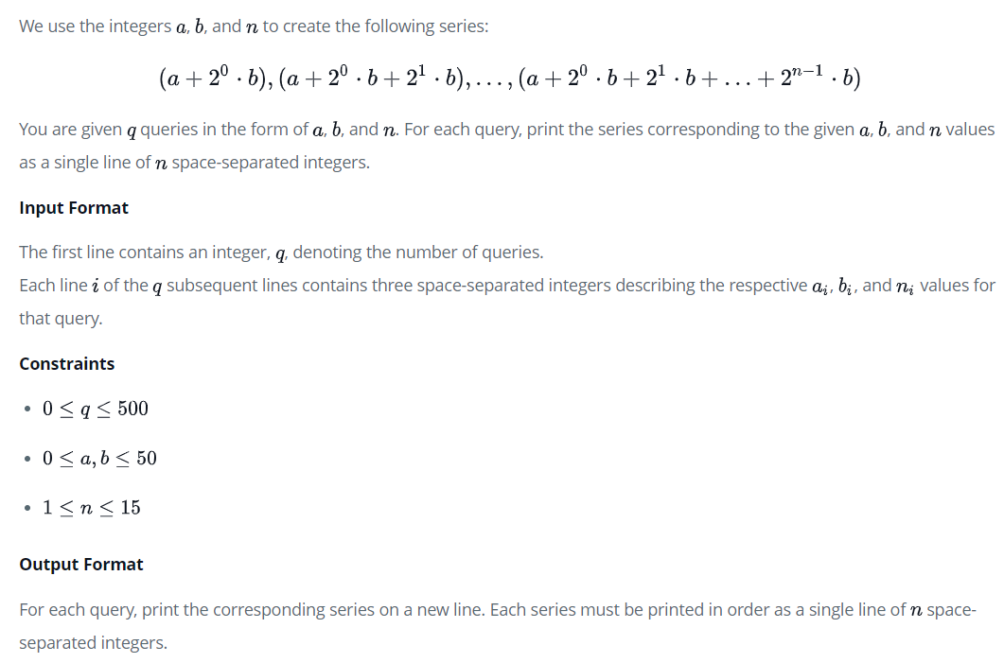
PRogram – 1: java Loops

Slide 3
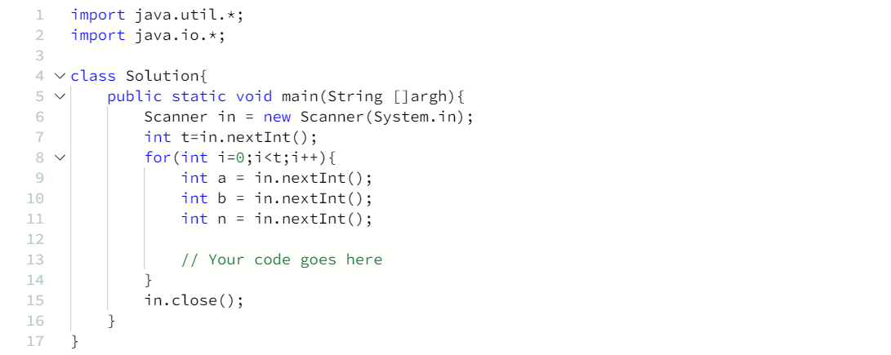
CODE SNIPPET:

Slide 4
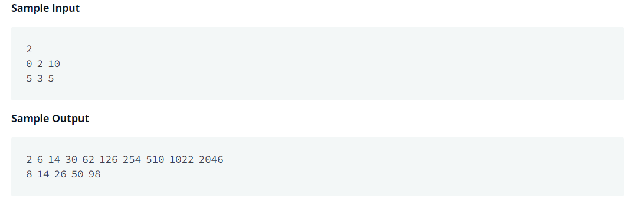
Sample Input & Output

Slide 5
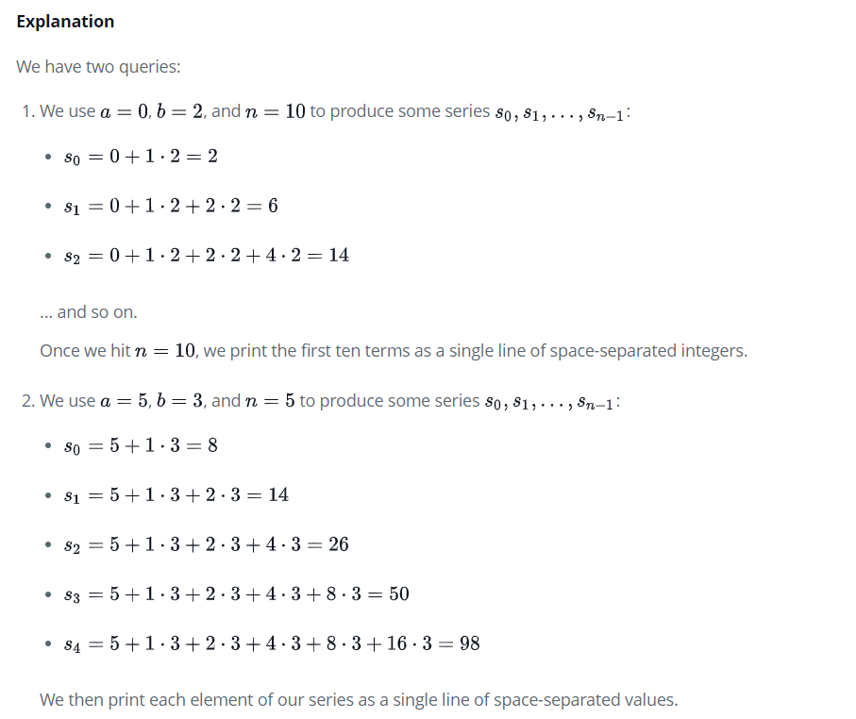
Sample Input & Output - Explanation

